Slide 1
Development of a small animal irradiation system
Magdalena Bazalova
Stanford University, CA, USA

Slide 2
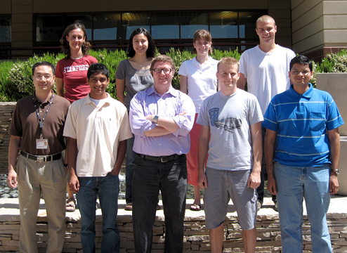
Small animal radiotherapy team
Edward Graves, PI
Paul Keall
Hu Zhou
Manuel Rodriguez
Geoff Nelson
Rahil Jogani
Amy Motomura
Fred van den Haak
Jiali Xu
Xinzhi Zhu
Yongjiang Xian
Phuoc Tran
Sanjeev Datta
and others

Slide 3
Why small animal radiotherapy
Rotating radiation sources, conformal collimators, image guidance and verification are widely used in modern RT.
Analogous systems for small animal RT lack most of these features.
Spatial and dosimetric accuracies achievable with existing systems are limited.
3D conformal animal RT systems are highly desirable.

Slide 4
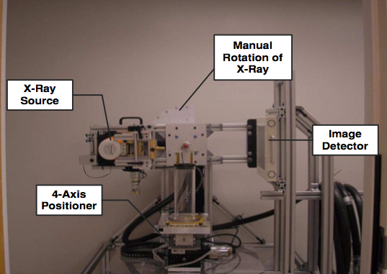
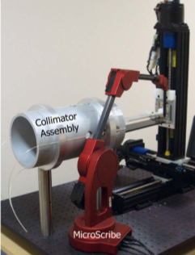
Current small animal RT systems
Washington University: ¹⁹²Ir with fixed collimators
John Hopkins University: imaging with 120kVp, treatment with 225kVp non-coplanar beams
Princess Margaret Hospital: a decomissioned simulator tube for imaging and 225kVp beam for treatment
Stanford: modified microCT scanner with 120kVp beam for both imaging and treatment

Slide 5
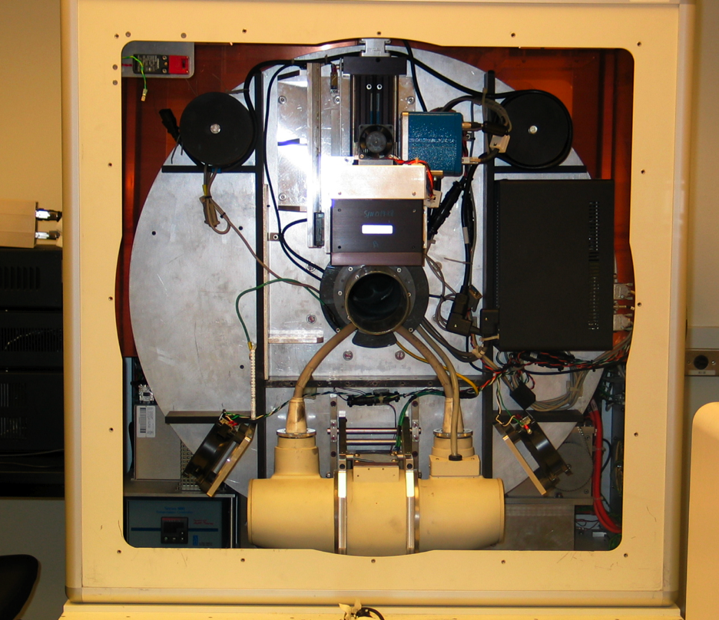
Stanford small animal radiotherapy
Based on an eXplore RS120 microCT scanner
Notes:
Figure 1ashows the scanner gantry. The body of the scanner, including the gantry on which the imaging system components are mounted and a cable rack through which the control PC communicates with these components, are enclosed in a lead shield. The CT isocenter is located at the center of a 70 plexiglass tube (the CT bore). The x-ray tube and detector are fixed on the gantry on opposite sides of the bore. The RS120microCT system has a stage housing inside which an animal couch stage moves along the CT axial direction (the z-axis in the CT coordinate system) to carry the animal into and out from the bore for imaging. A nose cone on this bed allows the continuous delivery of isoflurane anesthesia to a subject while it is on the scanner bed. The housing 75 provides an x-ray shield separate from the scanner itself to prevent radiation from exiting the device.

Slide 6
Turning an imaging device into a treatment machine
The tumor has to be positioned to the isocenter of the microCT scanner for treatment – two-dimensional translation stage.
The photon beam has to be conformal to the shape of the tumor – two-stage variable aperture collimator.

Slide 7
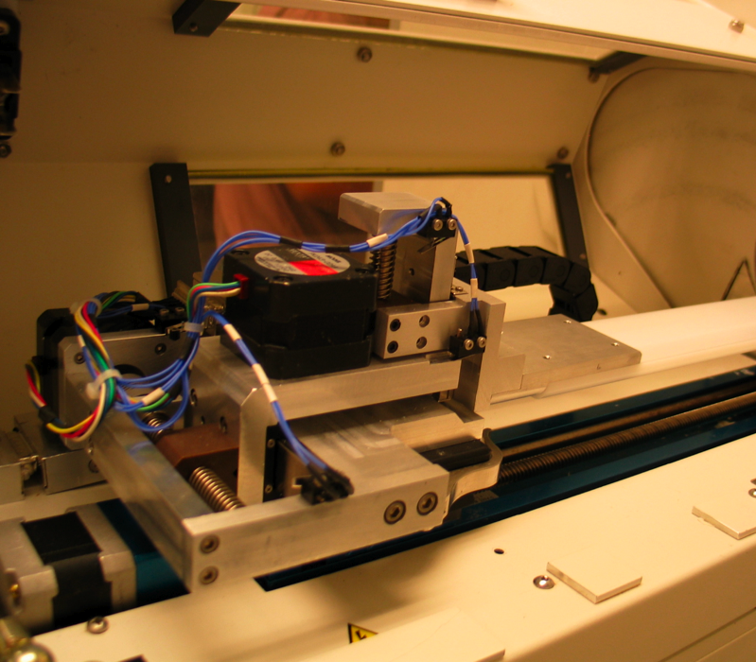
Two-dimensional translation stage
Mounted on the microCT couch (z axis), moves in x and y, controlled by a software (written in?) from the microCT computer.
The reproducibility is better than 0.05mm in both directions.

Slide 8
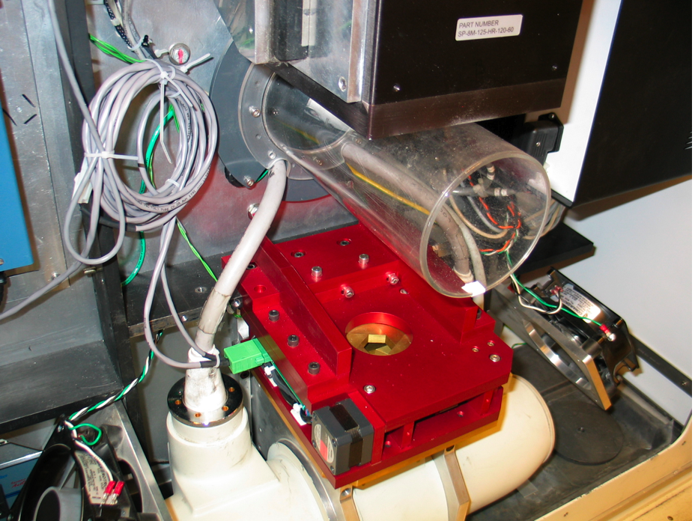
Collimator
A variable aperture collimator installed in the gantry between the x-ray source and the bore.
0 – 102 mm (fully open for imaging)
Notes:
Figure 1cshows the principle of the collimator, in which 12 pentagonal lead-brass blocks were arranged in two planes, forming two stages of collimation. The simultaneous sliding of the 6 blocks of each stage along their respective linear tracks forms a regular hexagonal aperture, whose width can be adjusted by the positions of the blocks. The two hexagonal apertures are arranged coaxially, offset by 30°, and each is driven by a stepper motor through a lead screw. The two stages will hereafter be referred to as the “near” collimator (closest to the x-ray source) and the “far” collimator. By setting the size of the two apertures to a constant ratio, equal to the distance ratio of the two hexagons from the x-ray source spot, a regular dodecagonbeam profile is formed. This design improves upon a previous rotationally-driven implementation (9) by moving to a more robust linear driving scheme. A position sensor attached to each stage reports the aperture size of the stage. A brass plate with a circular opening, attached to near side of the collimator, shields the control electronics within the device from irradiation. A graphical user interface (GUI) on the microCT control PC allows the user to specify collimator apertures, either independently or synchronized in order to fit the divergence of the x-ray beam.

Slide 9
Calibration of the collimator
Physical aperture vs machine unit calibration
Using solid cylinders with diameters ranging from 6mm to 36mm with precision of 0.025mm.
Readings of the position sensor fit with a linear function.
Collimator-beam axis alignment
Displacement and tilting have to be minimized
Split field test.
Imaging of a fixed object at 0° and 180°.
Evaluation of the hexagonal beam profiles.

Slide 10
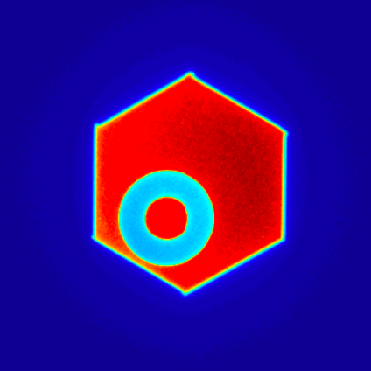
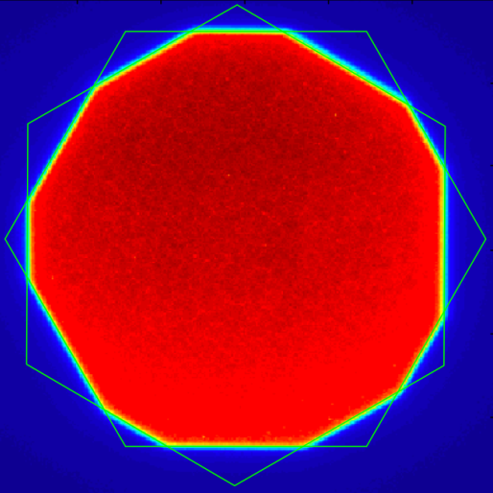
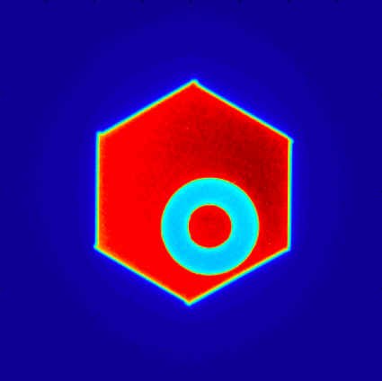
Collimator beam-axis alignment
o_{x}
0°
0°
180°
180°
Displacement and tilting adjustments after the calibration were less than 0.1 mm.
Notes:
Measurement of collimator alignment with the x-ray beam axis. A: Split field irradiation. The offset oxbetween the images from 0(darker) and 180(lighter) gantry angles is used to compute the offset of the collimator from the beam axis. B: Measurement of collimator offset by imaging a fixed object. The average of the object location seen at 0and at 180gives the scanner isocenter, while the collimator center can be measured based on the hexagonal profile. C: Measurement of collimator offset by fitting the hexagonal profiles produced by each 360 collimator stage, with both stages set at isocenter apertures of 20 mm. Asymmetry in the dodecagon is apparent, produced by offset between the centers of the two hexagons. The white scale bar is of length 2.5 mm at isocenter. D: Two hexagon analysis following iterative alignment of the collimator with the x-ray beam axis. The collimator apertures are set to 10 mm at isocenter to improve visual detection of any misalignment. The white scale bar is of length 365 2.5 mm at isocenter.

Slide 11
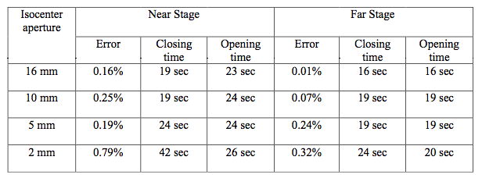
Collimator performance
Collimator motion times.
Notes:
Performance assessment of the collimator apparatus.

Slide 12
Dosimetric characterization of the system
Performed with EBT Gafchromic films and an ion chamber (PTW N30006).
EBT films offer high spatial resolution, they are tissue equivalent and show little energy dependence.
Films were read out at 508 dpi using a flatbed Epson Perfection V500 scanner in light transmission mode.
Notes:
The chamber is 0.6cc.

Slide 13
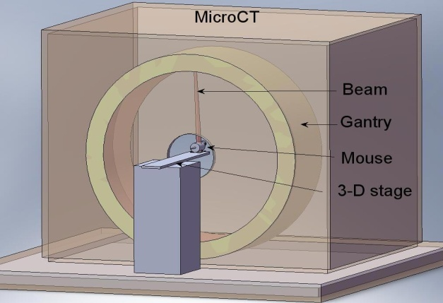
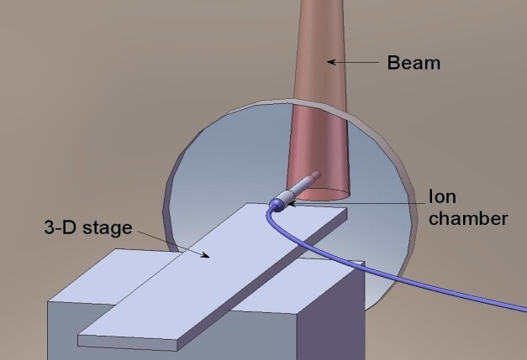
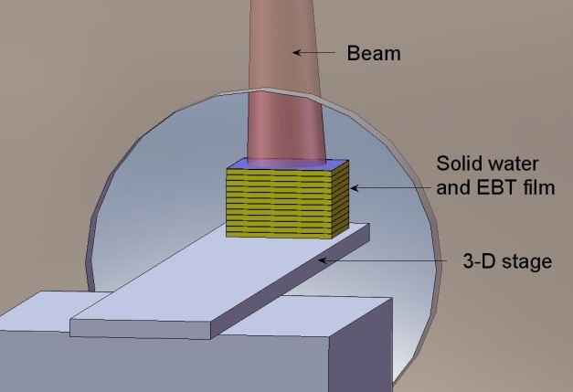
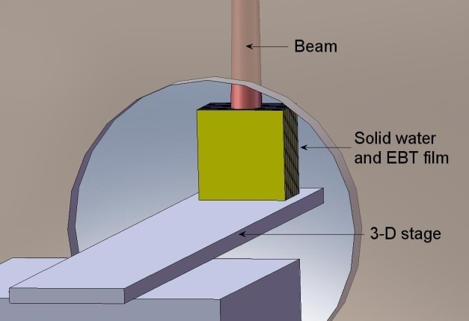
Dosimetric measurements
Notes:
a) Targets for irradiation are placed at the isocenter of the microCT and treated with beams from different angles. b) To measure the dose rate, the ion chamber was placed at the isocenter, in air, and irradiated with a photon beam of 120 kVp with a field diameter of 6 cm. c) To measure the percentage depth dose, gafchromic films were sandwiched in 6x6x0.3 cm³ solid water slabs and the top surface of the solid water was placed at the scanner isocenter. d) A single dose fraction was delivered to a gafchromic film sandwiched in solid, centered at the isocenter and placed parallel to the beam and the gantry rotation plane.

Slide 14
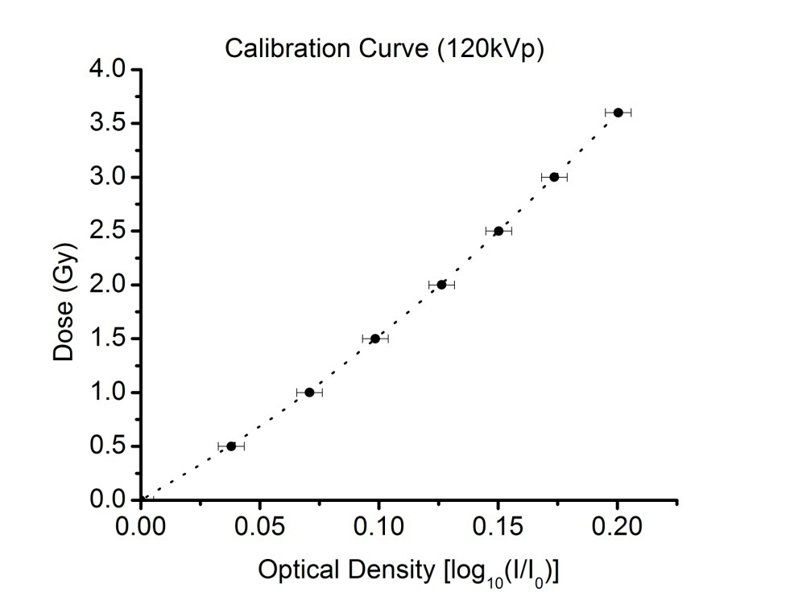
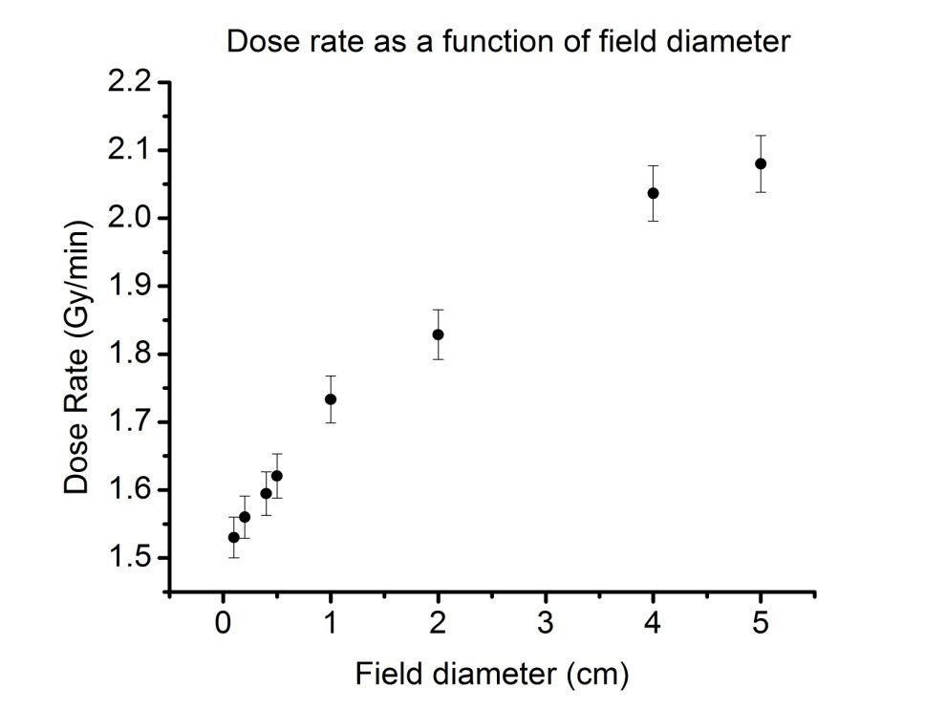
Dose rate as a function of beam size
Tube current | Dose rate (Gy/min)
(mA) |  | 6.0 cm | 5.0 cm | 4.0 cm
50 |  | 2.13 | 2.08 | 2.04
40 |  | 1.72 | 1.68 | 1.62
25 |  | 1.11 | 1.08 | 1.02
Notes:
Figure 4. Dose rate as a function of field diameter. The dose rate decreases as the field diameter decreases due to scatter reduction. The contribution of the scatter to the primary beam is more significant at low energies than at high energies. The error bar represents the overall uncertainty in the film measurements, 3.6%.

Slide 15
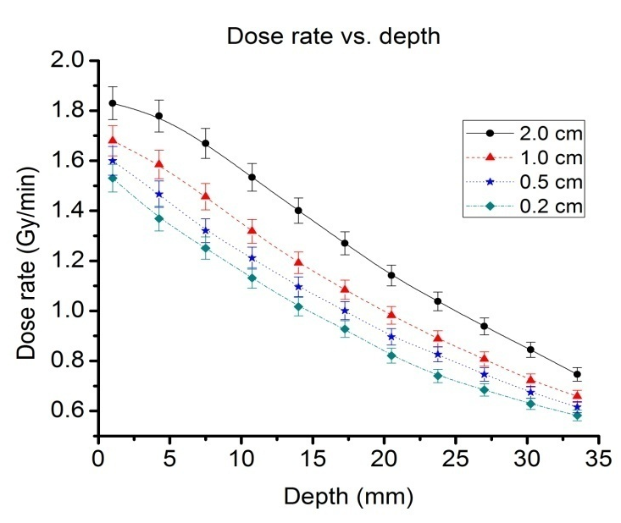
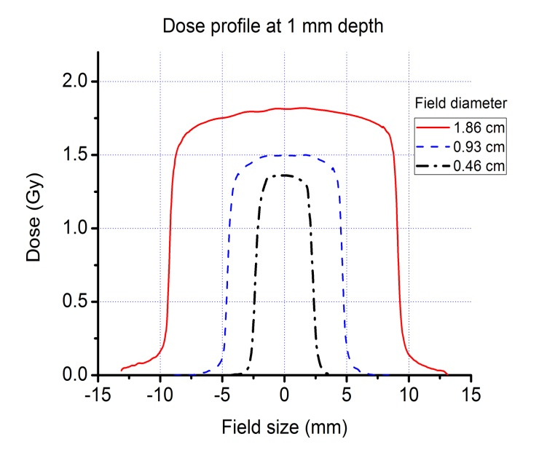
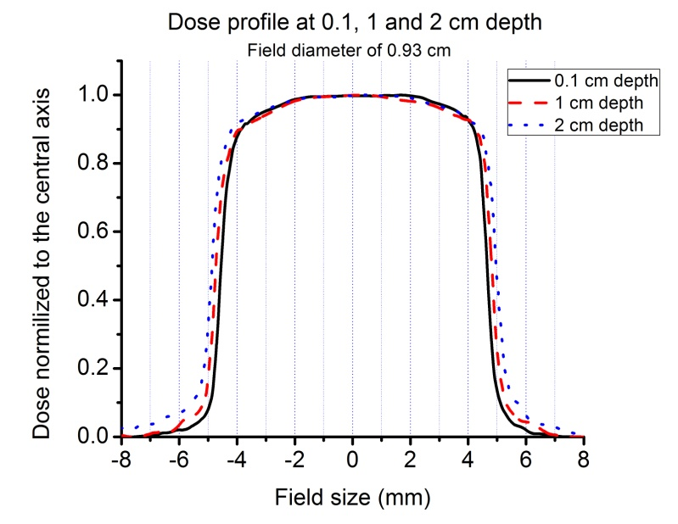
PDD and beam profiles
The dose rate is more than 1.5 Gy for beams as small as 2 mm.
Beam penumbra and heel effect studied.

Slide 16
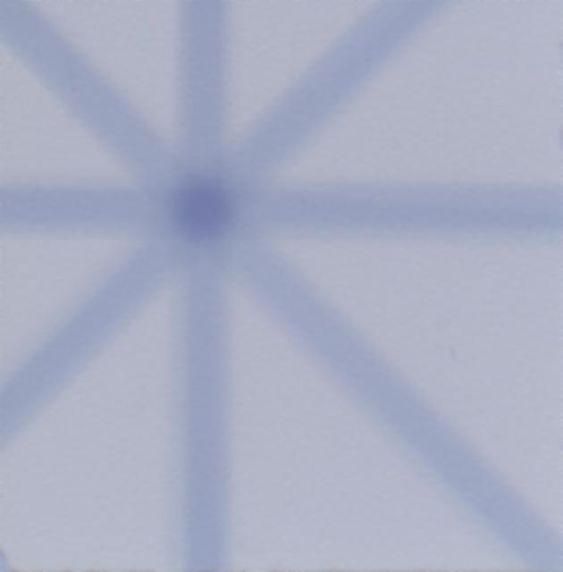
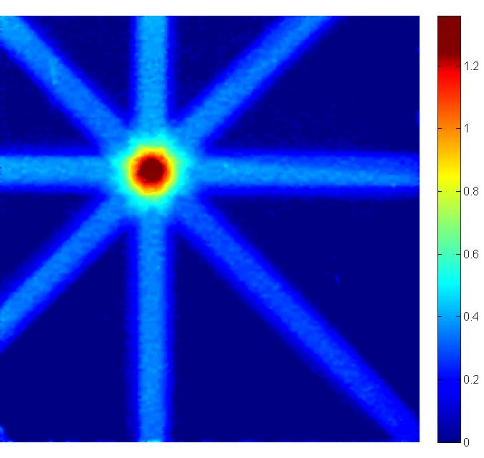
Plan delivery
8 beams with diameters of 2 mm.
The measured and calculated dose at the isocenter are within 1.5%
Notes:
Figure 7. a) Film irradiated with 8 beams with diameters of 0.2 cm. b) Dose distribution in the film. The difference between the calculated and measured dose is 1.5%. This single dose testing proved that the dosimetry of the system was consistent and that it can be used to deliver dose to internal organs in mice.

Slide 17
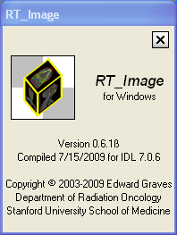
Treatment planning system
Under development
GUI based on RT_Image† is linked to a MC system based on the EGSnrc codes.
Inverse planning is being incorporated.
† Graves EE, Quon A, Loo BW. RT_Image: An Open-Source Tool for Investigating PET in Radiation Oncology. Technology in Cancer Research and Treatment2007;6:111-121.

Slide 18
Monte Carlo treatment planning for small animal radiotherapy
For kilovoltage photon beams, the dose has to be calculated by the Monte Carlo (MC) method.
We investigated
the efficiency of MC dose calculation for kV photon beams in submillimeter voxels
the importance of tissue segmentation for kV photon beam
BEAMnrc and DOSXYZnrc EGSnrc codes are used.
Two methods for dose calculations are studied and optimized.
Dual-energy microCT imaging is studied.

Slide 19
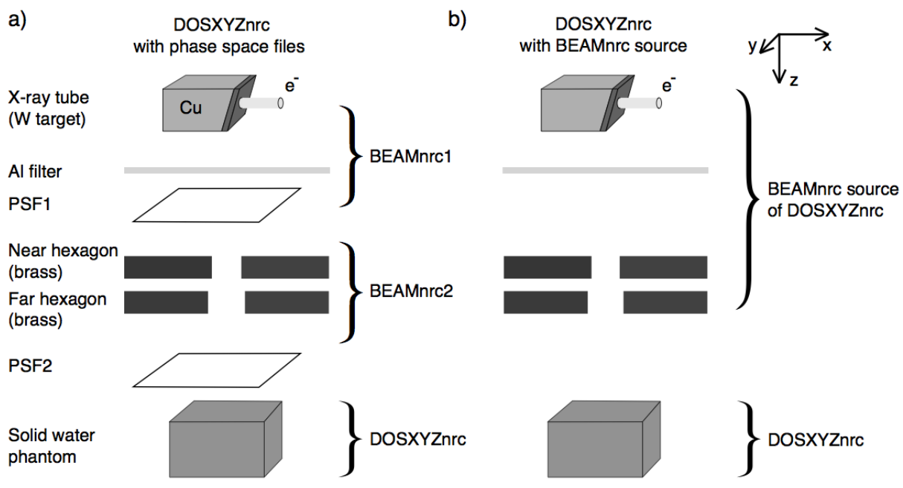
MC dose calculations

Slide 20
Two calculation approaches: comparison
For (0.2×0.2×0.2) mm³, 120 kVp beam
beam < 30 mm phase-space files
beam > 30 mm
BEAMnrc source
3.0 GHz machine

Slide 21
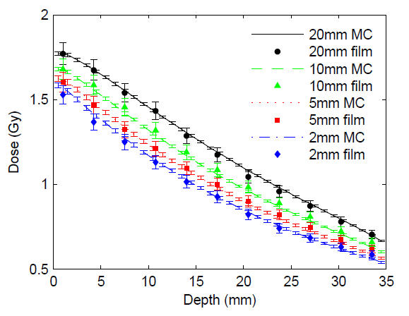
Comparison of MC dose distributions to measurements
Using PDD curves and beam profiles parallel and perpendicular to heal effect

Slide 22
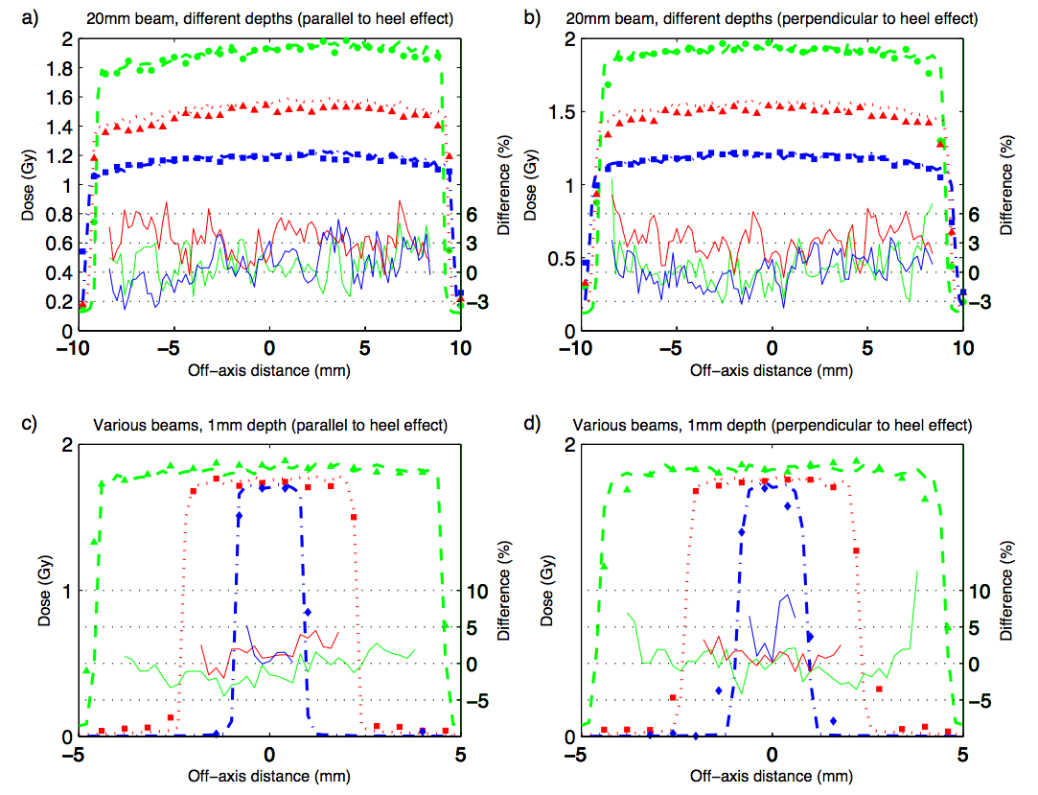
Beam profiles

Slide 23
Tissue segmentation
How important is it for MC dose calculations using the microCT 120kVp beam?
a)
b)
ICRU tissues
0.3<ρ<1.9
(g/cm³)
6.7<Z<14.0
34 ICRU
tissues
c)

Slide 24
Tissue segmentation - Results
Need to know Z.

Slide 25
Dual-energy microCT (DEmCT) imaging
DEmCT is based on a parameterization of the linear attenuation coefficient.
Results in ρ and Z of each voxel.
Tested on a mouse phantom and a calibration phantom with 70 and 120 kVp beams.

Slide 26
DEmCT phantom: Results
ρ and Z extracted with a reasonable accuracy
beam hardening does seem to play a role (will be investigated)
noise is an important issue, image quality should be improved

Slide 27
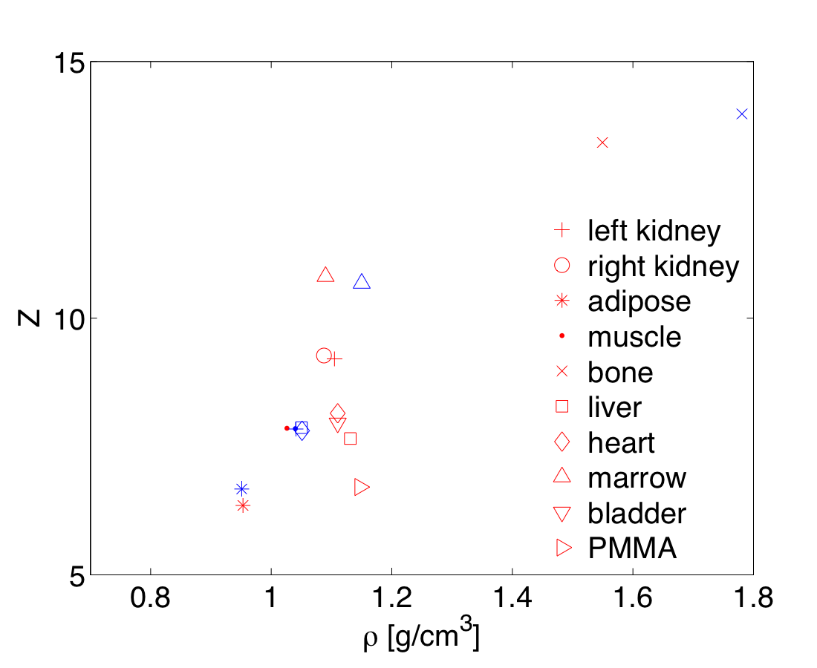
DEmCT of a frozen mouse
11 organs of a mouse delineated and the mean HU of each organ used for DEmCT
mouse extracted
ICRU human tissues

Slide 28
RT_Image

Slide 29
RT_Image and EGSnrc
Interactive tissue and mass density segmentation.
EGSnrc input file is created, run on an 8-core Mac.

Slide 30
RT_Image is cool

Slide 31
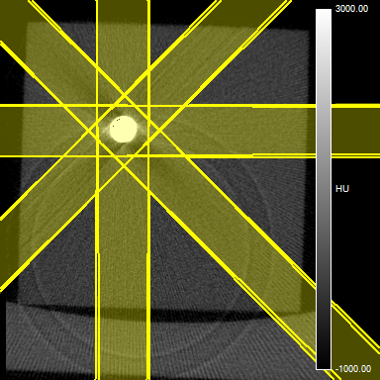
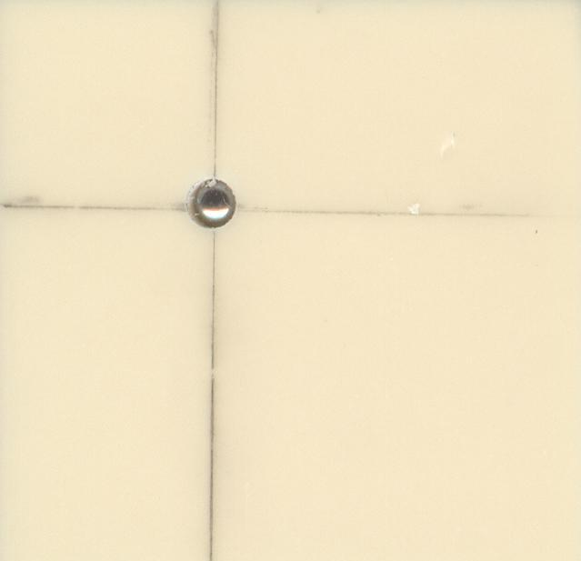
Phantom irradiation
Notes:
In order to establish that this hybrid microCT/RT system could accurately localize an arbitrary target within a subject for irradiation, a phantom was constructed. The phantom consisted of ten sheets of solid watermeasuring 3 x 3 x 0.3 cm stacked to form a cube. Within one of the central sheets, a hole of diameter 0.3 cm was drilled at a location of (10 mm, 10 mm) from the upper left corner. A 3 mm diameter metal sphere was secured in the center of this hole, andsheets of radiochromic film were sandwiched within the solid water stack above and below the sheet bearing the sphere. This phantom was then placed on the microCT subject bed and secured so that the films and solid water sheets were coplanar with the plane of rotation of the scanner gantry. The phantom was imaged using a standard microCT protocol (400 views, 0.9 view increment, 70 kV, 40 mA, 25 ms exposure per view). The image data was reconstructed at an isotropic resolution of 0.1 mm per pixel and viewed with RT_Image. The location of the metal sphere was identified in the microCT images, and the translation stage offsets needed to shift the sphere to the scanner isocenter were calculated. These offsets were applied, and subsequently the phantom was irradiated with 8 beams spaced at 45 increments, using exposure times calculated from beam commissioning data to deliver a total dose of 1 Gy at isocenter (12). The film was then removed and the dose profile on it was used to assess the accuracy of targeting of the metal sphere.

Slide 32
Mouse irradiation
MYC-induced lung tumors of two mice irradiated to a dose of 2 Gy.
Anesthetized mice were imaged at 70 kV.
The target was localized and an 8 equally spaced beam plan was created.
After irradiation, the mice were sacrificed and tissue were harvested. The lungs fixed in formalin and cut into 20 mm sections.
Notes:
12 To assess whether this unit could be used to deliver conformal radiotherapy to a murine subject, we irradiated tumors in the lungs of two mice to a dose of2 Gy at isocenter. Transgenic mice were created that, when treated with tetracycline, specifically express the MYC oncogene in the cells of the lung. These mice develop spontaneous lung carcinomas within a median of 52 weeks 190 of MYC induction (13). Two of these mice bearing late-stage disease (greater than 52 weeks post-induction) were selected for treatment with radiotherapy. A subject mouse was placed on the microCT bed and anesthetized with isoflurane, delivered continuously through a nose cone on the bed. MicroCT data was acquired as 400 projections equally spaced over 360 (tube voltage 70 kV, tube current 40 mA, 25 ms exposure per projection), which were then 195 reconstructed into volumetric CT images using a cone beam algorithm. The reconstructed 3D volume was loaded into RT_Image to localize the desired target and calculate the appropriate position settings for the 3D translation stage and the collimator. After adjusting the stages and collimator, radiotherapy was delivered as a series of 8 beams equally spaced over 360to a dose of 2 Gy at isocenter. A Monte Carlo model was used to simulate the dose distribution produced 200 by this treatment (14). Immediately following irradiation, the mice were sacrificed and tissues were harvested. The lungs of the mice, including the target tumors, were excised, fixed in formalin, and cut into 20 mm sections. They were then stained with antibodies against H2AX, a histone protein that is recruited to the site of double strand breaks (15), as well as DAPI to visualize cell nuclei. These 205 immunohistochemical sections were then visualized with fluorescence microscopy. As the mice developed multiple lesions within the lungs, comparisons were made in H2AX staining between Zhou 13 the tumor on which radiation was focused and other tumors that received background levels of radiation.

Slide 33
Mouse irradiation (cont.)
The section were stained with antibodies against γH2AX (double strand breaks) and DAPI (to visualize cell nuclei).
The immunohistochemical (fixed tissue) sections were visualized with fluorescence microscopy.
Notes:
12 To assess whether this unit could be used to deliver conformal radiotherapy to a murine subject, we irradiated tumors in the lungs of two mice to a dose of2 Gy at isocenter. Transgenic mice were created that, when treated with tetracycline, specifically express the MYC oncogene in the cells of the lung. These mice develop spontaneous lung carcinomas within a median of 52 weeks 190 of MYC induction (13). Two of these mice bearing late-stage disease (greater than 52 weeks post-induction) were selected for treatment with radiotherapy. A subject mouse was placed on the microCT bed and anesthetized with isoflurane, delivered continuously through a nose cone on the bed. MicroCT data was acquired as 400 projections equally spaced over 360 (tube voltage 70 kV, tube current 40 mA, 25 ms exposure per projection), which were then 195 reconstructed into volumetric CT images using a cone beam algorithm. The reconstructed 3D volume was loaded into RT_Image to localize the desired target and calculate the appropriate position settings for the 3D translation stage and the collimator. After adjusting the stages and collimator, radiotherapy was delivered as a series of 8 beams equally spaced over 360to a dose of 2 Gy at isocenter. A Monte Carlo model was used to simulate the dose distribution produced 200 by this treatment (14). Immediately following irradiation, the mice were sacrificed and tissues were harvested. The lungs of the mice, including the target tumors, were excised, fixed in formalin, and cut into 20 mm sections. They were then stained with antibodies against H2AX, a histone protein that is recruited to the site of double strand breaks (15), as well as DAPI to visualize cell nuclei. These 205 immunohistochemical sections were then visualized with fluorescence microscopy. As the mice developed multiple lesions within the lungs, comparisons were made in H2AX staining between Zhou 13 the tumor on which radiation was focused and other tumors that received background levels of radiation.

Slide 34
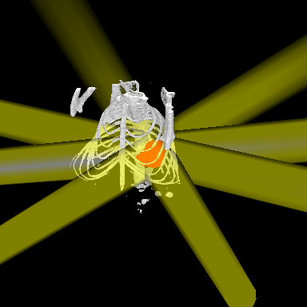
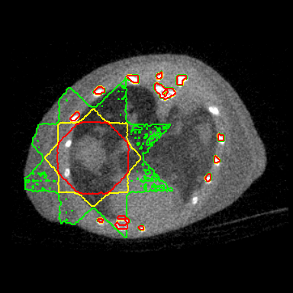
Mouse irradiation plan
Notes:
45 minutes for plan, setup and delivery. (including planning and imaging? I guess not…)

Slide 35
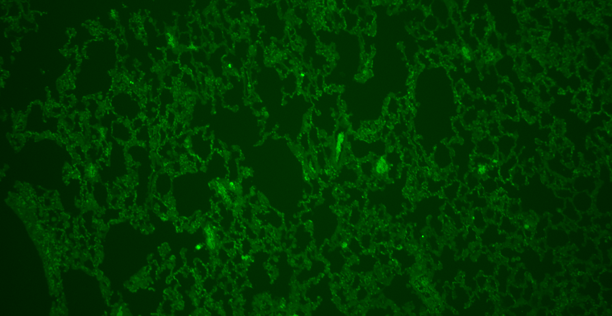
Fluorescence imaging
~2 Gy
~0.3 Gy
γH2AX
DAPI

Slide 36
Discussion
Increase in temperature of the x-ray tube generator – reduce duty cycle and take breaks between irradiations
Tissue segmentation using DEmCT imaging is limited by microCT image quality. Noise has to be reduced.

Slide 37
Conclusions
A GE microCT scanner was successfully modified for delivery of radiation to small animals.
MC treatment planning is close to its final version.
Inverse treatment planning is being incorporated.
More than 20 mice have been irradiated.
Ready to irradiate more animals and study the response of various tumors/tissues to radiation.
For less than $25,000 (plus a microCT scanner).

Slide 38
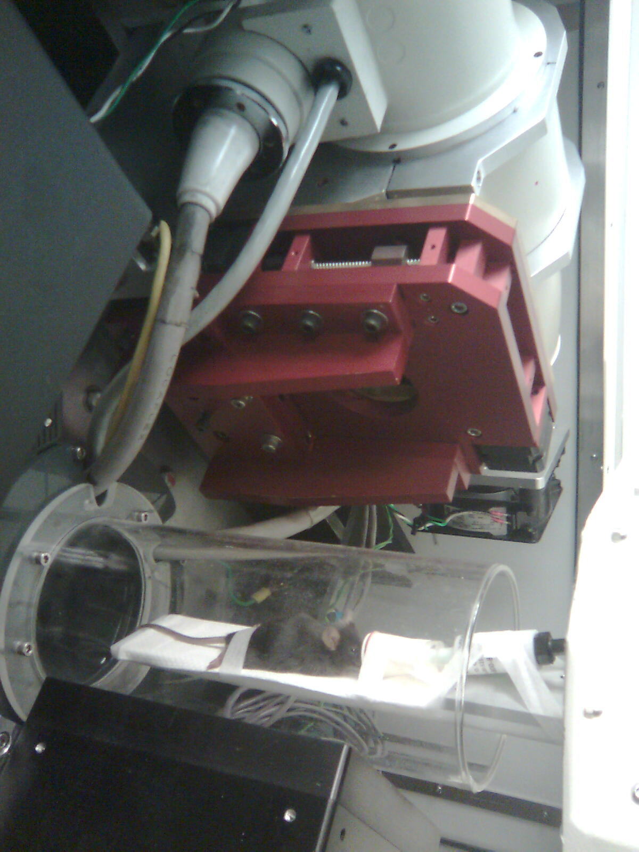
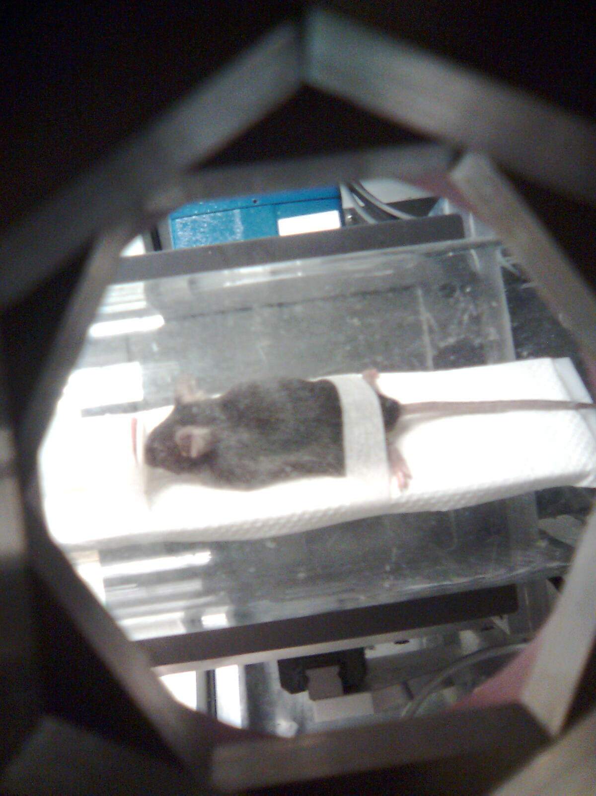
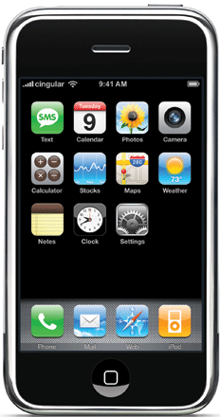
Small animal irradiation

