Slide 1
Monte Carlo treatment planning for small animal microCT-based radiotherapy
M. Bazalova, H. Zhou, P. Keall, E. Graves
Stanford University, CA, USA

Slide 2
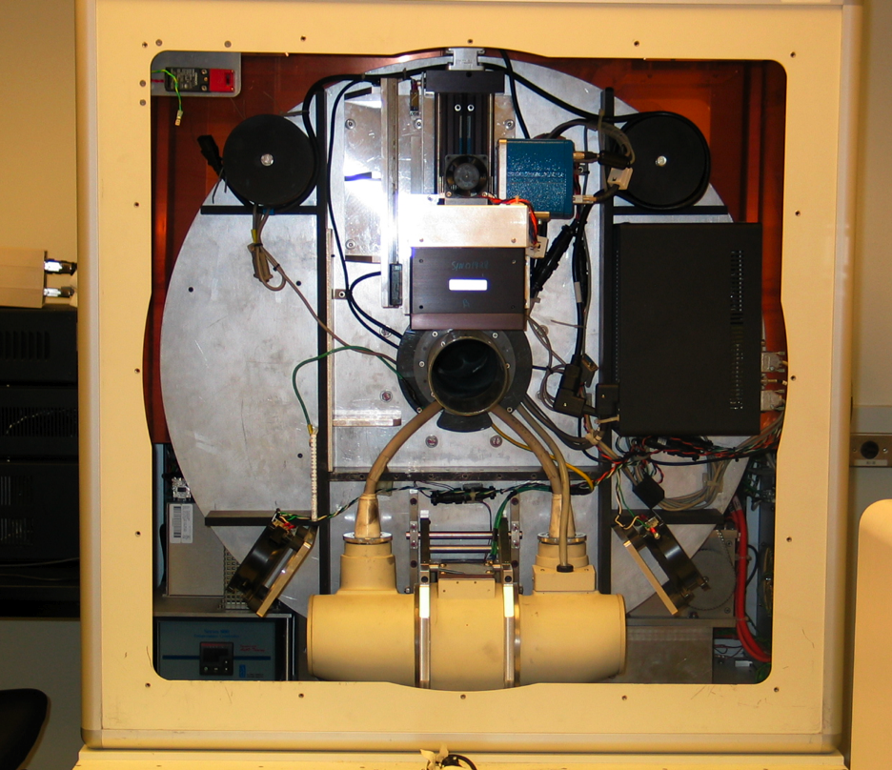
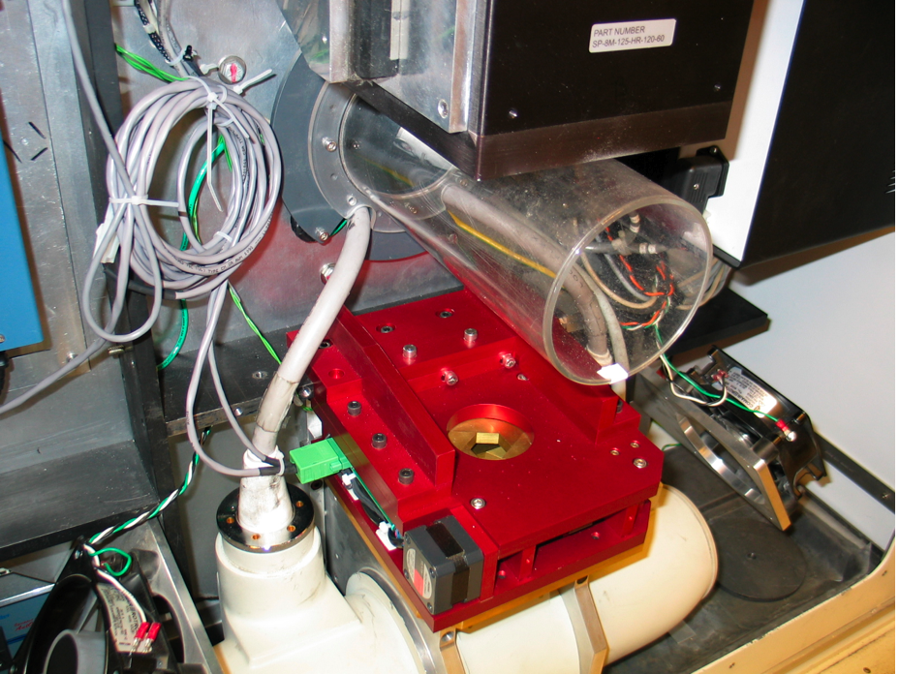
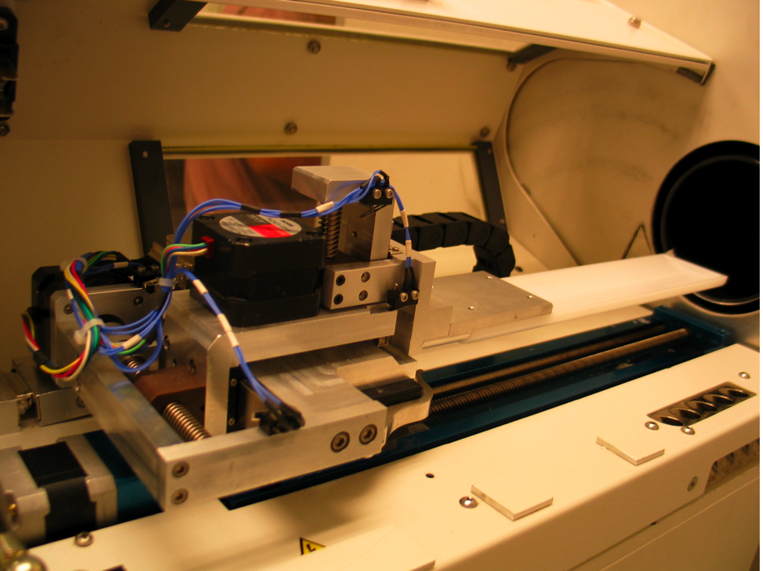
Small animal radiotherapy at Stanford
microCT
2 stage
collimation
system
collimator
design
2D transl.
stage

Slide 3
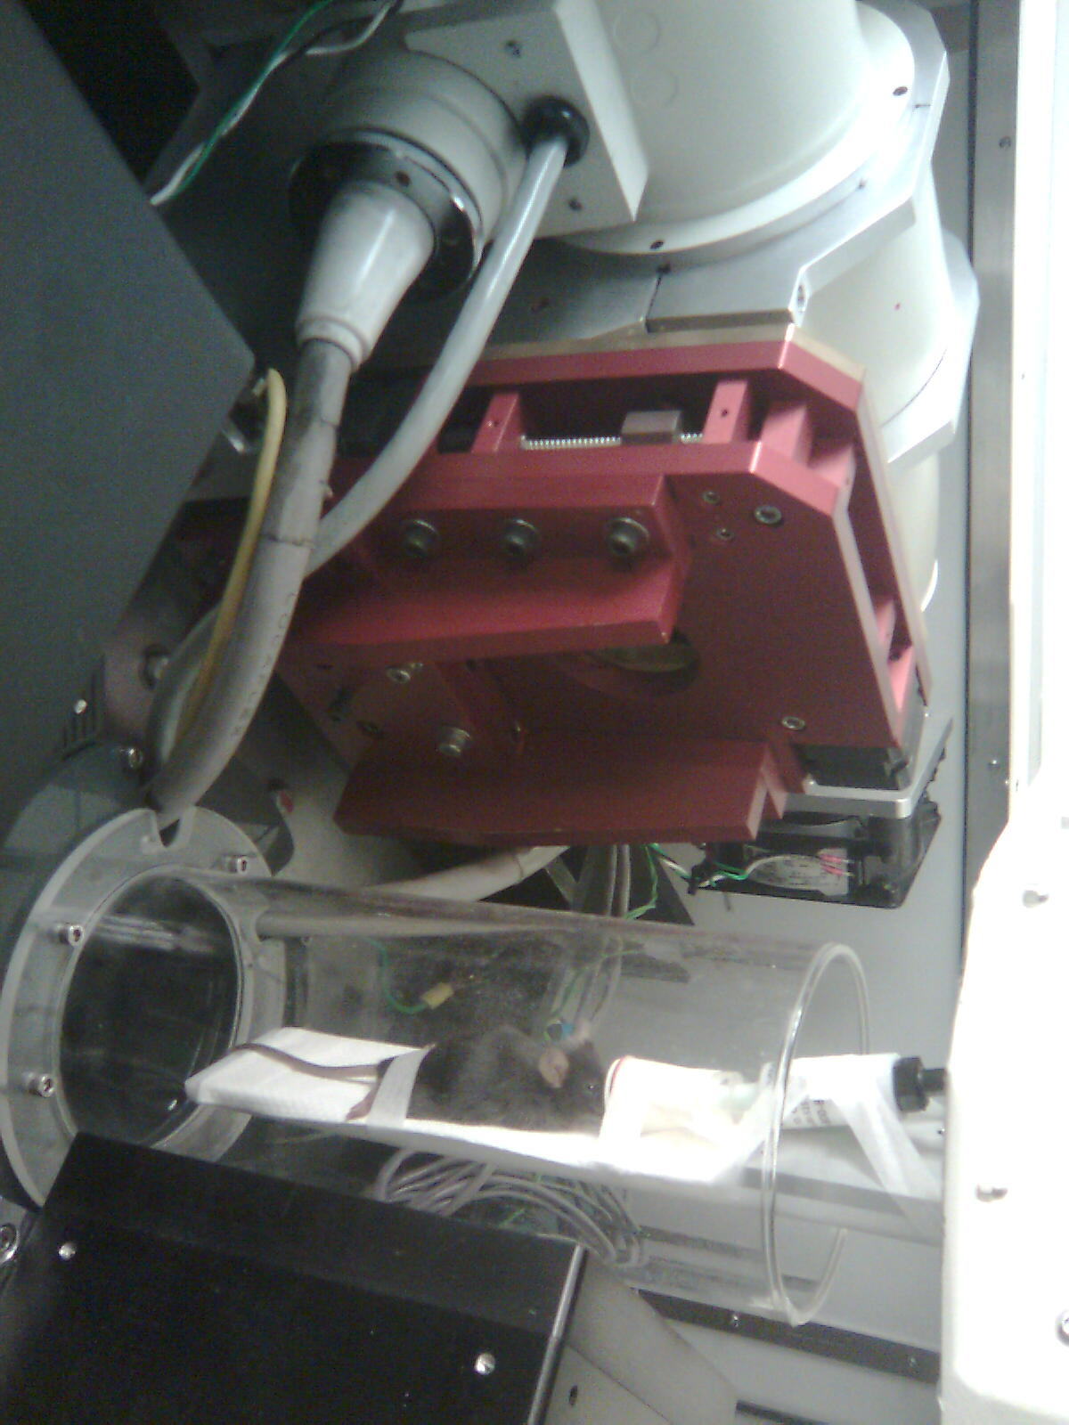
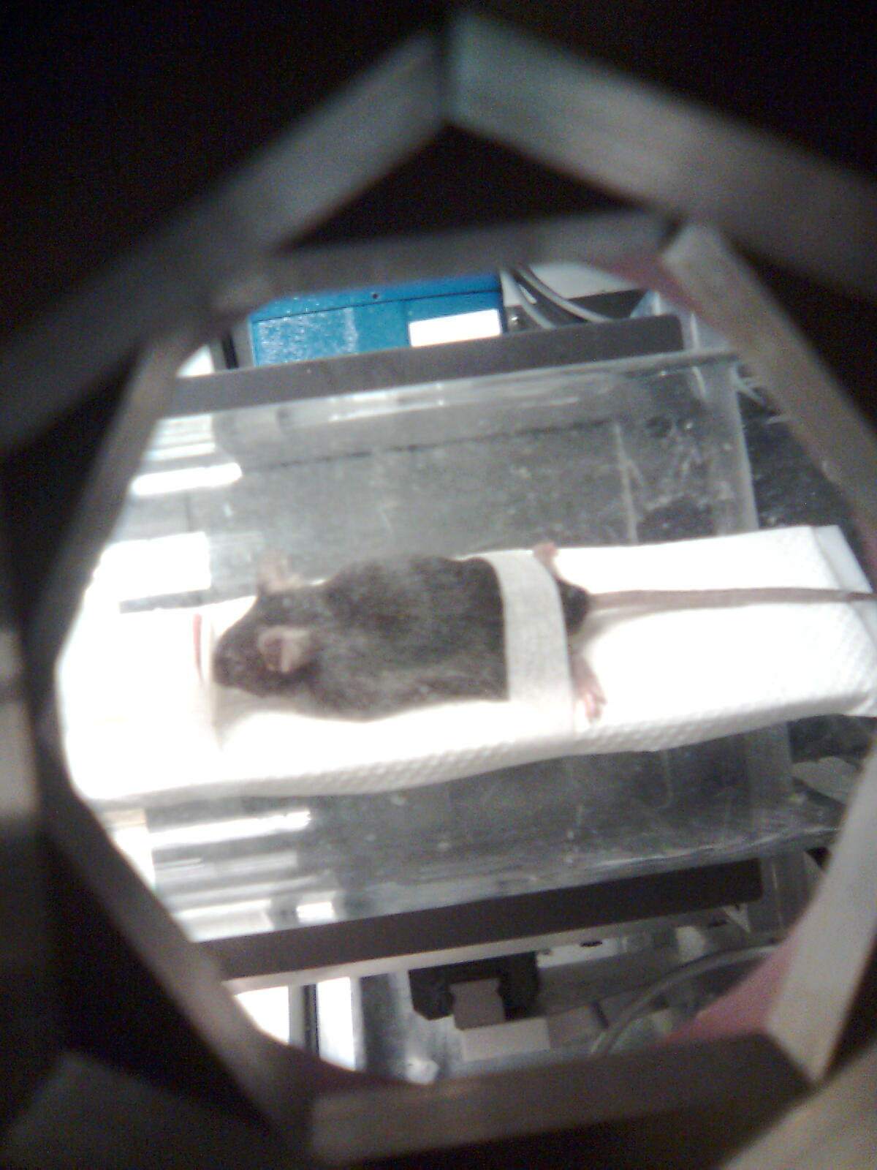
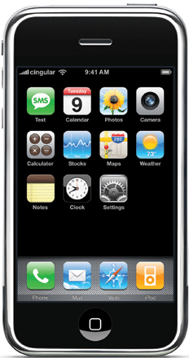
Small animal irradiation

Slide 4
Motivation
For kilovoltage photon beams, the dose has to be calculated by the Monte Carlo (MC) method.
The aim of this work is to investigate
the efficiency of MC dose calculation for kV photon beams in submillimeter voxels
the importance of tissue segmentation for kV photon beam
BEAMnrc and DOSXYZnrc EGSnrc codes are used.
Two methods for dose calculations are studied and optimized.
Dual-energy microCT imaging is studied.

Slide 5
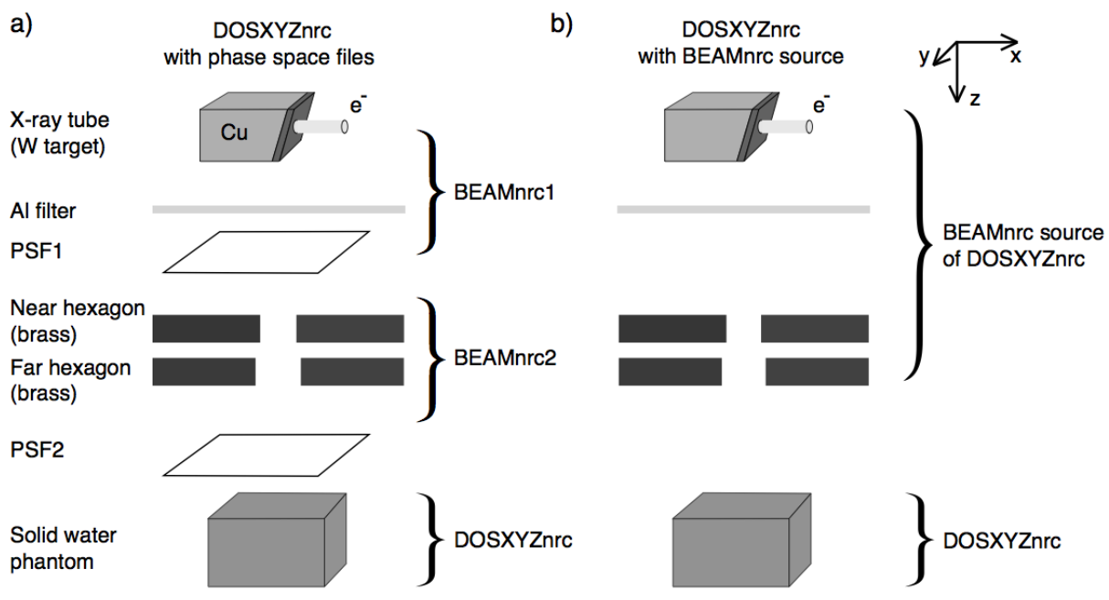
MC dose calculations

Slide 6
Two calculation approaches: comparison
For (0.2×0.2×0.2) mm³, 120 kVp beam
beam < 30 mm phase-space files
beam > 30 mm
BEAMnrc source
3.0 GHz machine

Slide 7
Tissue segmentation
How important is it for MC dose calculations using the microCT 120kVp beam?
a)
b)
ICRU tissues
0.3<ρ<1.9
(g/cm³)
6.7<Z<14.0
34 ICRU
tissues
c)

Slide 8
Tissue segmentation - Results
Need to know Z.

Slide 9
Dual-energy microCT (DEmCT) imaging
DEmCT is based on a parameterization of the linear attenuation coefficient.
Results in ρ and Z of each voxel.
Tested on a mouse phantom and a calibration phantom with 70 and 120 kVp beams.

Slide 10
DEmCT phantom: Results
ρ and Z extracted with a reasonable accuracy
beam hardening does seem to play a role (will be investigated)
noise is an important issue, image quality should be improved

Slide 11
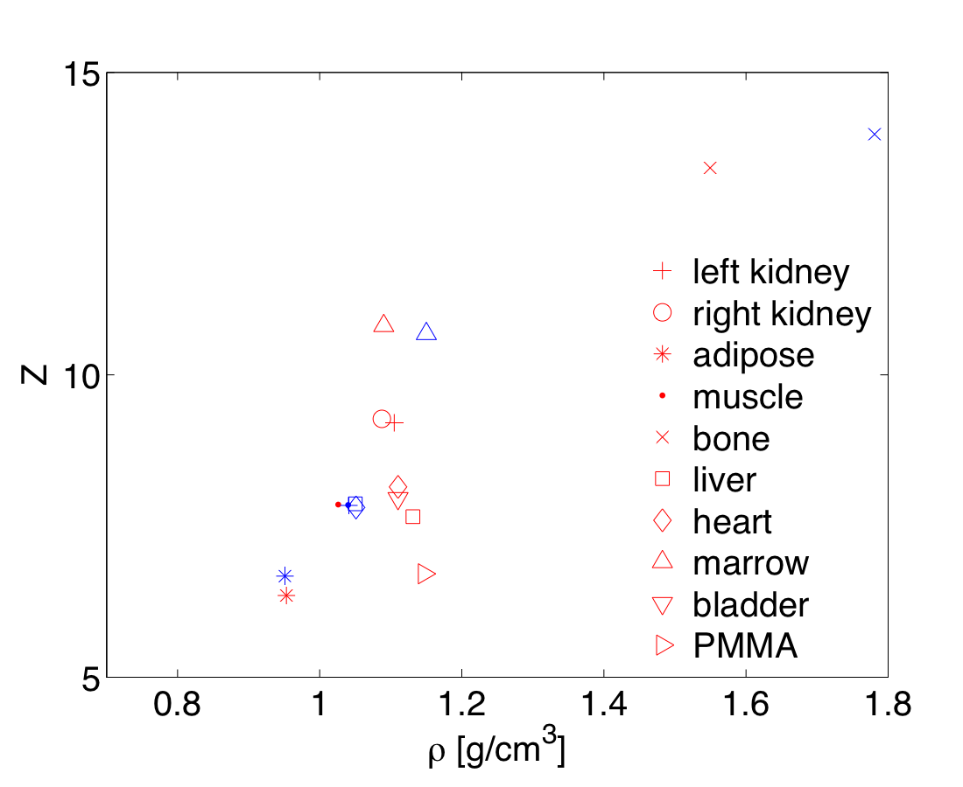
DEmCT of a frozen mouse
11 organs of a mouse delineated and the mean HU of each organ used for DEmCT
mouse extracted
ICRU human tissues

Slide 12
Conclusions
Monte Carlo dose calculations using the EGSnrc codes for microCT-based small animal radiotherapy have been investigated.
For beams with diameters larger than 30 mm, BEAMnrc sources should be used as opposed to phase-space files.
Tissue segmentation is an important factor. the absorbed dose in a tissue correlates with the atomic number Z of the tissue.
Dual energy microCT is a promising technique for tissue segmentation for small animal radiotherapy dose calculations.

Slide 13
Acknowledgements
Geoff Nelson
Manuel Rodriguez
Rahil Jogani
Fred van den Haak
The work is supported by NIH grant R01 CA131199.

