Slide 1
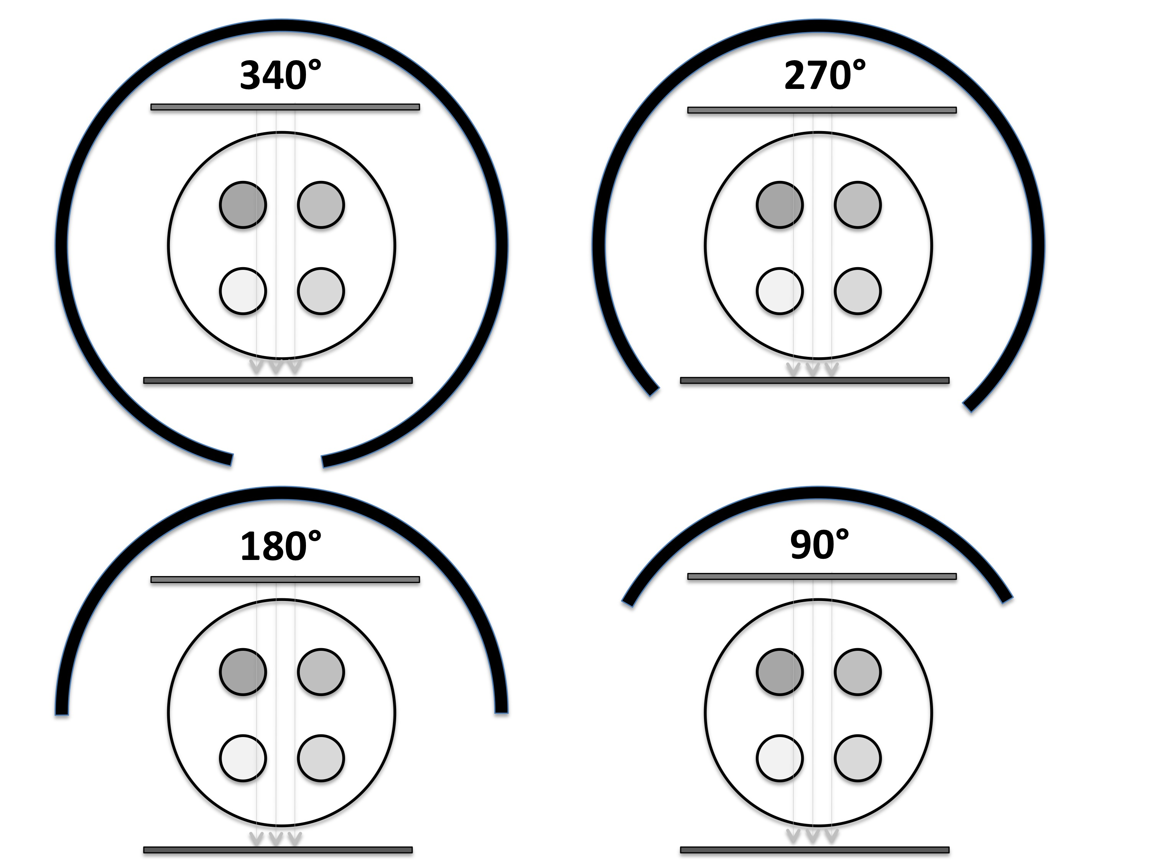
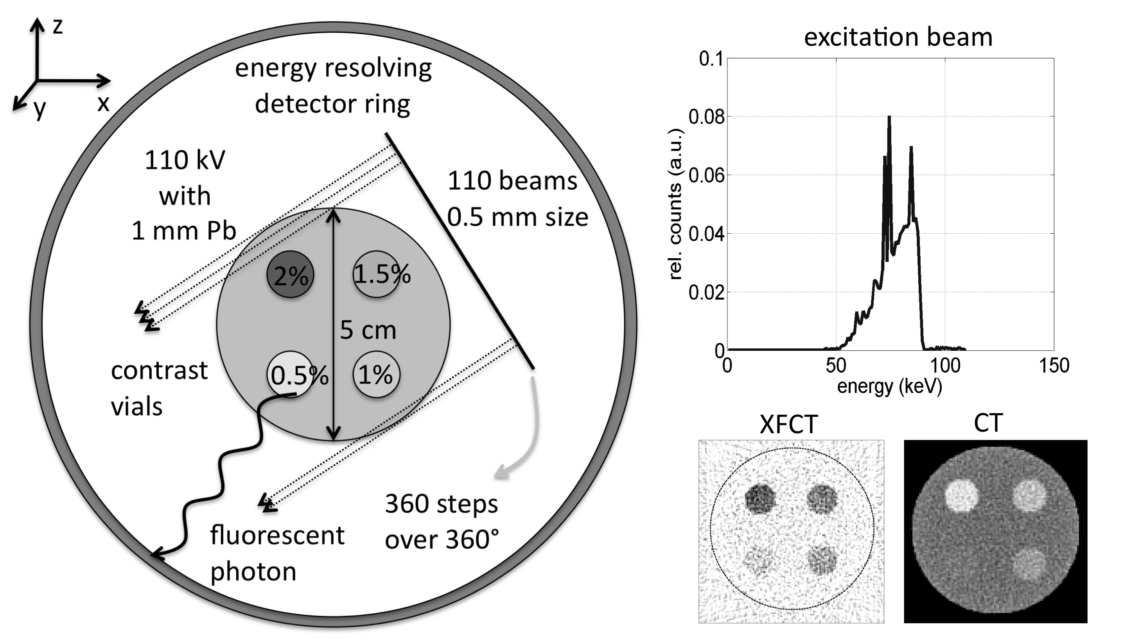
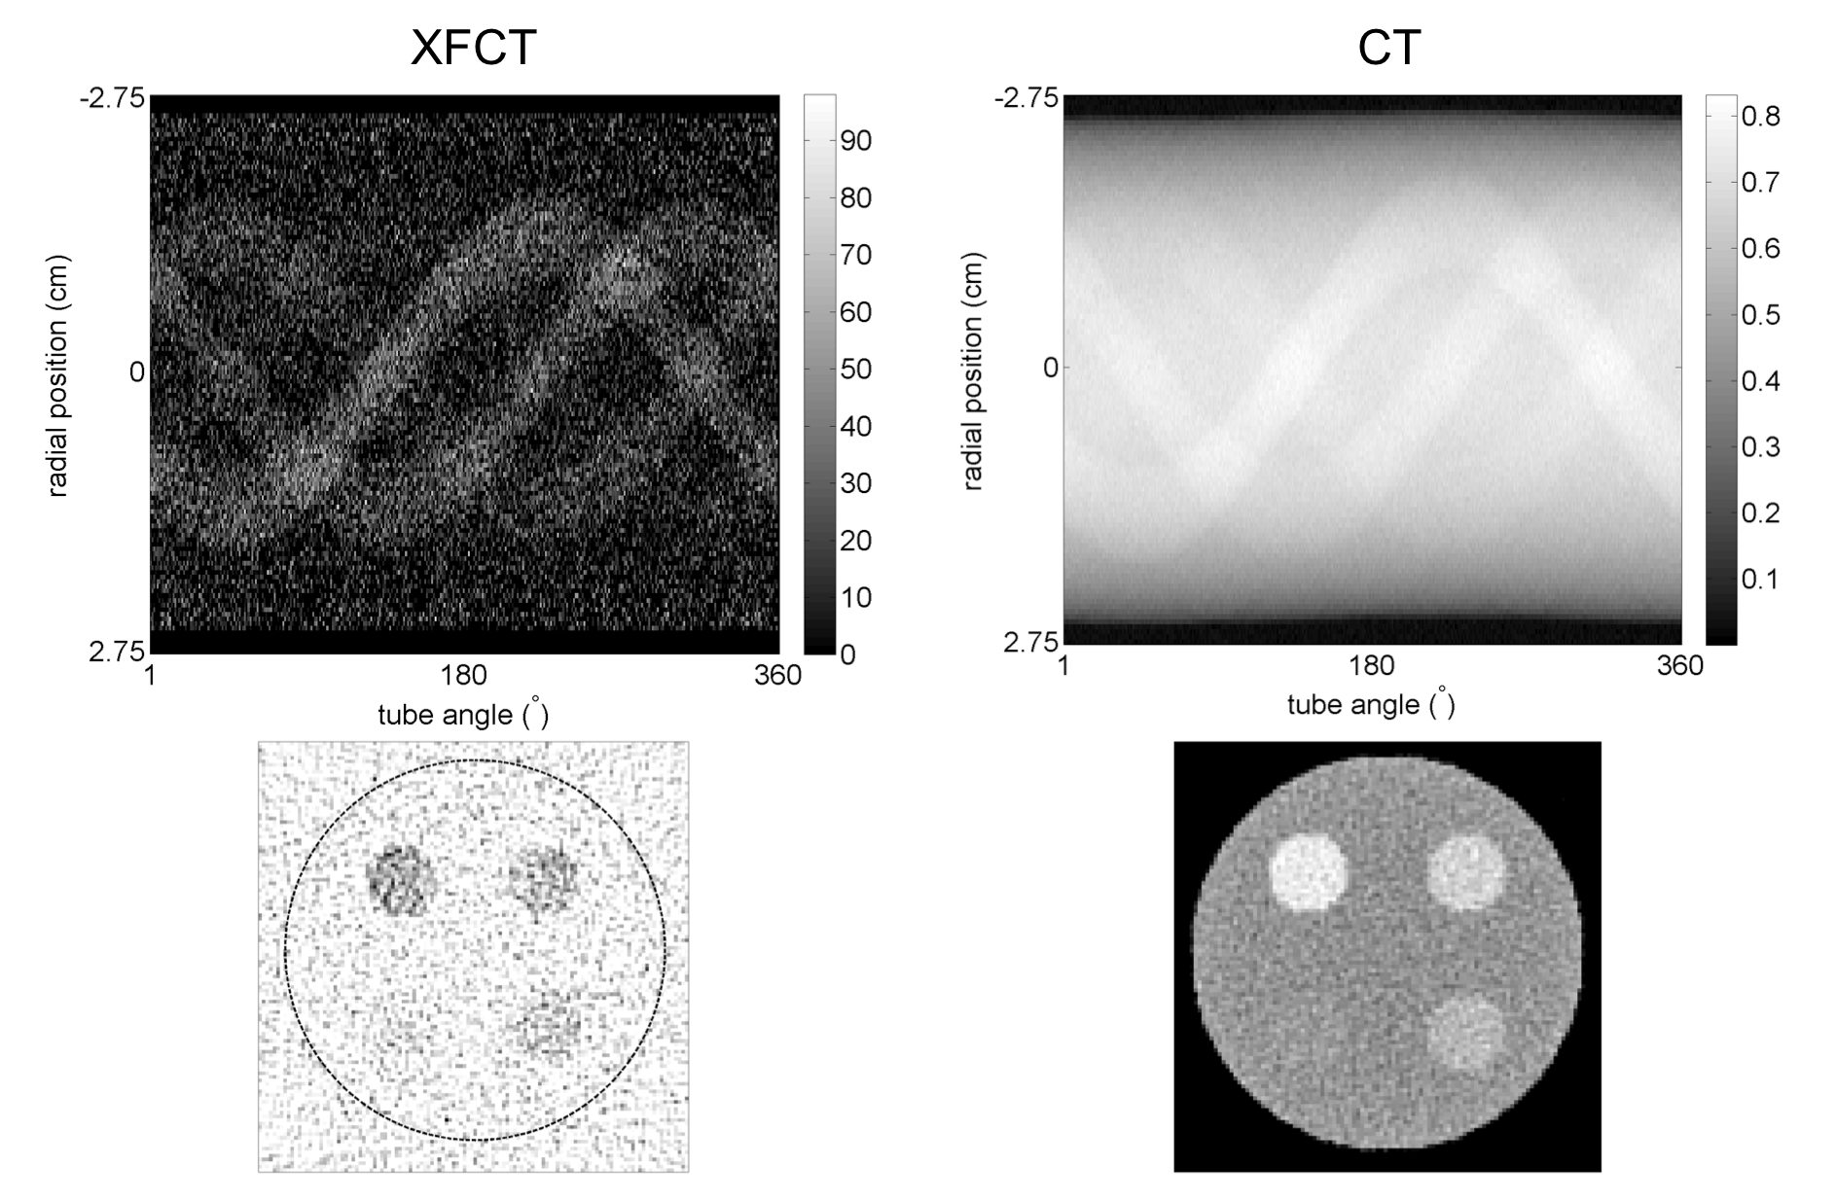
X-RAY FLUORESCENCE CT FOR IMAGING OF GOLD NANOPARTICLES AND CISPLATIN Magdalena Bazalova*, Yu Kuang, Guillem Pratx, and Lei Xing Department of Radiation Oncology, Stanford University, Stanford, CA
INTRODUCTION
Conventional x-ray CT imaging performed with photon-integrating detectors offers high spatial resolution and fast scanning times. Currently, CT lacks behind other imaging modalities in providing molecular contrast due to its limited sensitivity. Probes containing high atomic number elements can be potentially imaged at low concentrations using x-ray CT scanners equipped with photon-counting detectors with x-ray fluorescence CT (XFCT)[1]. In this work, a CT/XFCT x-ray system for imaging of gold nanoparticles (Au) and Cisplatin (Pt) was simulated and thoroughly investigated using the Monte Carlo method.
METHODS AND MATERIALS
Detector arrangement
Image reconstruction
Monte Carlo model
Figure 2: Simulation geometry for the study of the number of detectors (left) and Compton scatter reduction (right).
Figure 4: Energy spectrum for a single sinogram point of the low-resolution phantom loaded with gold (a) and platinum (b) imaged with 0.1 mGy.
Phantoms
Figure 1: Simulation setup of x-ray fluorescence and transmission CT imaging. The x-ray excitation source was a 110 kV photon beam (spectrum shown on the right). Examples XFCT and transmission CT images simulated in the EGSnrc/DOSXYZnrc code are also presented.
Figure 3: The low-resolution (a), high-resolution high-concentration (b), high-resolution low-concentration (c), and bone (d) phantoms used for investigation of image quality. Phantoms (a), (b), and (c) were filled with both Au and Pt.
Figure 5: Example sinograms (top) and reconstructed CT images (bottom) for XFCT (left) and transmission CT (right) for 0.1 mGy.
RESULTS
Reconstructed CNR of XFCT images as a function of imaging parameters/system
Reconstructed XFCT and CT images
Figure 6: XFCT images of the low-resolution phantom loaded with gold (top) and platinum (bottom) as a function of imaging dose.
Figure 9: Reconstructed concentration (a,b) and CNR (c,d) as a function of contrast concentration and imaging dose for gold (a,c) and platinum (b,d) based on simulations of the low-resolution phantom imaged with 2 mGy dose.
Figure 10: CNR for 0.5%-2.0% concentrations of platinum as a function of detector width (a), discrete detector angular coverage (b, Figure 2 left), detector energy resolution (c), and continuous detector angular coverage (d, Figure 2 right).
XFCT and CT comparison
Figure 7: XFCT, CT and overlay XFCT/CF images of the high-resolution high-concentration phantom with gold (top) and platinum (bottom) acquired with a full detector ring. XFCT images (first column) and conventional transmission CT images (second column) for imaging dose of 2 mGy are presented.
Figure 8: CT, XFCT and overlay CT/XFCT images of the bone phantom depicted in Figure 3. Note that gold is not visible in the CT image alone.
Figure 11: CNR of XFCT and CT images for gold and platinum as a function of contrast agent concentration and object size for concentration of 0.1% to 2.0 %. Imaging dose is 2 mGy. The sensitivity of XFCT is higher than CT for most cases.
COnclusions
With the recent advances in photon-counting detector technology, XFCT may become a competing molecular imaging modality for probes containing high-Z elements. Simultaneous CT/XFCT imaging has the potential to become a useful tool for in-vivo imaging, as it produces CT images with combined anatomical and molecular information.
acknowledgements
references
We would like to acknowledge the support from NCI (1R01 CA133474 and 1R21 408 CA153587) and NSF (0854492).
[1] S.-K. Cheong, B. L. Jones, A. K. Siddiqi, F. Liu, N. Manohar and S. H. Cho, "X-ray fluorescence computed tomography (XFCT) imaging of gold nanoparticle-loaded objects using 110 kVp x-rays," Phys Med Biol 55, 647-662 (2010).

